Slide 1
Automatic document classification
Andreea Teodora Ionescu, SPF
Bogdan Gabriel Georgescu, SSA

Slide 2
Contents
Problem trying to solve
The solution
How it works?
Prerequisites and dataset
Results
Conclusions

Slide 3
Problem trying to solve
Document classification (especially news articles)

Slide 4
The solution Latent Dirichlet Allocation
Form of unsupervised learning
Most popular topic modeling algorithm
Discover topics that are part of the given documents
Used to classify text in a document to a topic

Slide 5
How LDA works for our problem?
Learning
Apply the algorithm on the chosen data set to generate the model
Create
Repeat first step until model fits expectations
Run
Apply the previously generated model on a new article/document
See
Show the topics for the given article/document

Slide 6
How does our solution work?
The user inputs the URL of a news page
The app crawls the given web page and extracts the text
It removes 90-95% of html tags, scripts and other metadata
The text is sanitized using tokenization, stop-word removal and stemming
The model is applied to the resulted tokenized text and the topics are shown back to the user

Slide 7
Dataset
Dataset formed of five news categories:
Cooking
Fashion
Medicine
Technology
Sport

Slide 8
Data cleaning
Text Preprocessing
Python packages
Tokenization segments the document into its atomic elements
Remove stop words (‘for’, ‘or, ‘the’) from token list.
Stemming words reduce topically similar words to their root.
Gensim: Free Python library for unsupervised topic modeling and NLP
NLTK: a natural language toolkit for Python, used for tokenization and stemming
Stop_words: a Python package containing stop words
PyLDAvis: Python package for interactive LDA visualization
Pattern: used to only keep the nouns

Slide 9
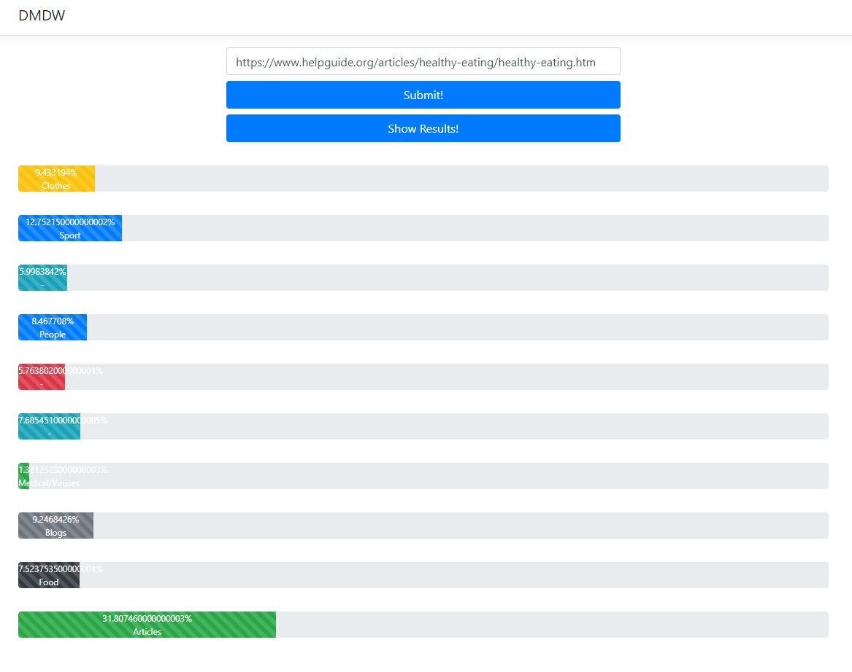
Results

Slide 10
Conclusion
The main advantage of the algorithm is that it shortens the large collection of documents to some commonly occurring words or phrases
The proposed solution gives insigth into the topics of an article in less than a few seconds
This solution can be applied to calssify into topics a collection of articles from multiple sources

Slide 11
Questions?
Keywords
LDA
Topics
Document classification
Gensim

